Slide 1

STUDENT DETAILS
NAME: Pranavi Tangudu
SkillsBuild Email ID: pranavitiot121@siesgst.ac.in
AICTE ID: STU64b264bb655201689412795
College Name: SIES Graduate School of Technlogy
College State: Maharashtra
Internship Domain: Cyber Security
Internship Start and End Date: 13th Oct 2023 to 24th Nov 2023

Slide 2
STEGANOGRAPHY HIDING MESSAGE IN AN IMAGE PROJECT
This project is focused on overcoming the challenge of creating the strong method for hiding messages in digital images.
This is a method which aims to provide excellent security, hold a lot of data, resist attacks, be easy for users to work with, and perform quickly in real-time.
The ultimate objective is to develop a reliable and secure solution that can be used for safeguarding data, ensuring secure communication, and meeting the needs of cybersecurity applications.

Slide 3
AGENDA
Introduction to Steganography and its importance
Project Overview
Target Audience
Solution and Value Proposition
Customization of the Project
Modeling Techniques
Results and Outcomes
Relevant Links

Slide 4
PROJECT OVERVIEW
Our project is centered around creating a steganography solution that is both secure and easy for users to navigate, enabling the concealment of messages within digital images. The main objective is to guarantee the secrecy of hidden information, all the while optimizing data capacity and preserving image quality. Our aim is to develop a user-friendly tool that not only prioritizes robust security but also withstands detection attempts. This practical solution is intended for use in various applications, including data protection, secure communication, and cybersecurity.

Slide 5
WHO ARE THE END USERS of this project?
This steganography project serves the broad spectrum of users. Security experts, governmental entities, and corporations find value in its adept ability to conceal data securely, guaranteeing the confidentiality and privacy of the sensitive information. Researchers and academics leverage its capabilities for studying information concealment and security, while everyday users can effortlessly safeguard their personal data and communications. The diverse range of users highlights the project's widespread applicability in fortifying data security and privacy across the diverse sectors.

Slide 6
YOUR SOLUTION AND ITS VALUE PROPOSITION
Our offering is a steganography tool that empowers users to conceal messages within the images, employing a password for robust encryption. It caters to the end users by furnishing a secure and uncomplicated method for conveying sensitive information. The merit it delivers lies in elevated privacy and security, assuring that solely the designated recipient has the capability to unveil the concealed messages.

Slide 7
How did you customize the project and make it your own
We introduced the user-friendly interface to broaden the tool's accessibility.
To bolster security, we integrated a password-based encryption.
Our code encompasses both encryption and decryption features, rendering it the comprehensive steganography solution.
We have enhanced code readability and implemented minor optimizations to boost the performance.

Slide 8
MODELLING
OpenCV in Image Processing: Leveraged OpenCV for image loading, manipulation, and storage, allows detailed pixel-level control.
Pixel-Level Adjustments: Altered color channels at pixel level to subtly embed messages.
Security Boost with Password Encryption: Improved security through password-based encryption serving as the cryptographic key.
Character-to-Value Mapping: Utilized dictionaries to convert the characters to integers for efficient processing.
Modular Organization: Structured the code into a functions for clarity and ease of maintenance.
Error Management: Integrated mechanisms for gracefully handling the potential issues.
User-Friendly Interface: Possibly incorporated an interface for the user convenience during interactions.

Slide 9
Results
Effective Concealment of Messages: Messages are seamlessly embedded within the images without detection.
Robust Encryption: Message security is guaranteed through encryption based on the user passwords.
Favorable User Response: Users appreciated the tool for its effectiveness and user-friendly design.
Optimal Performance: The tool operates efficiently, even with the large image files.
Effective Error Management: Users receives the clear guidance through well-handled error situations.
Prospects for Advancement: The project holds potential for incorporating the advanced features and expanding its capabilities.

Slide 10
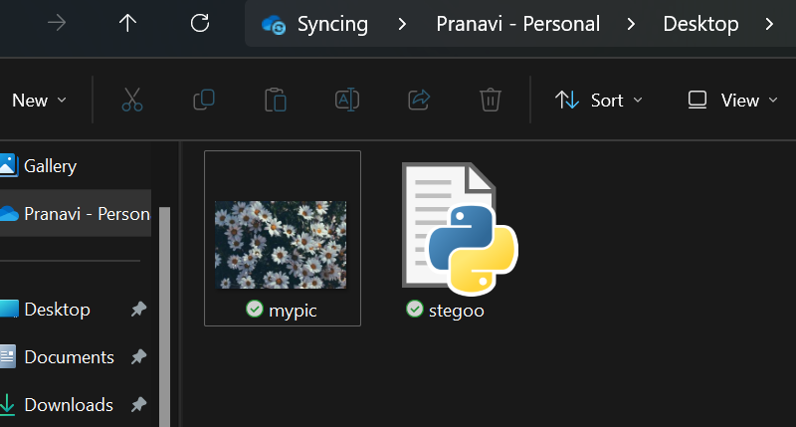
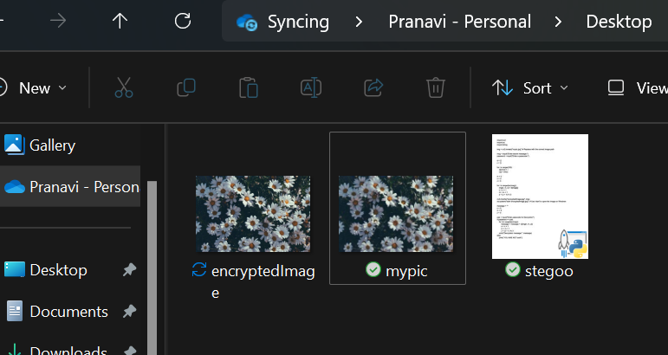
Execution

Slide 11
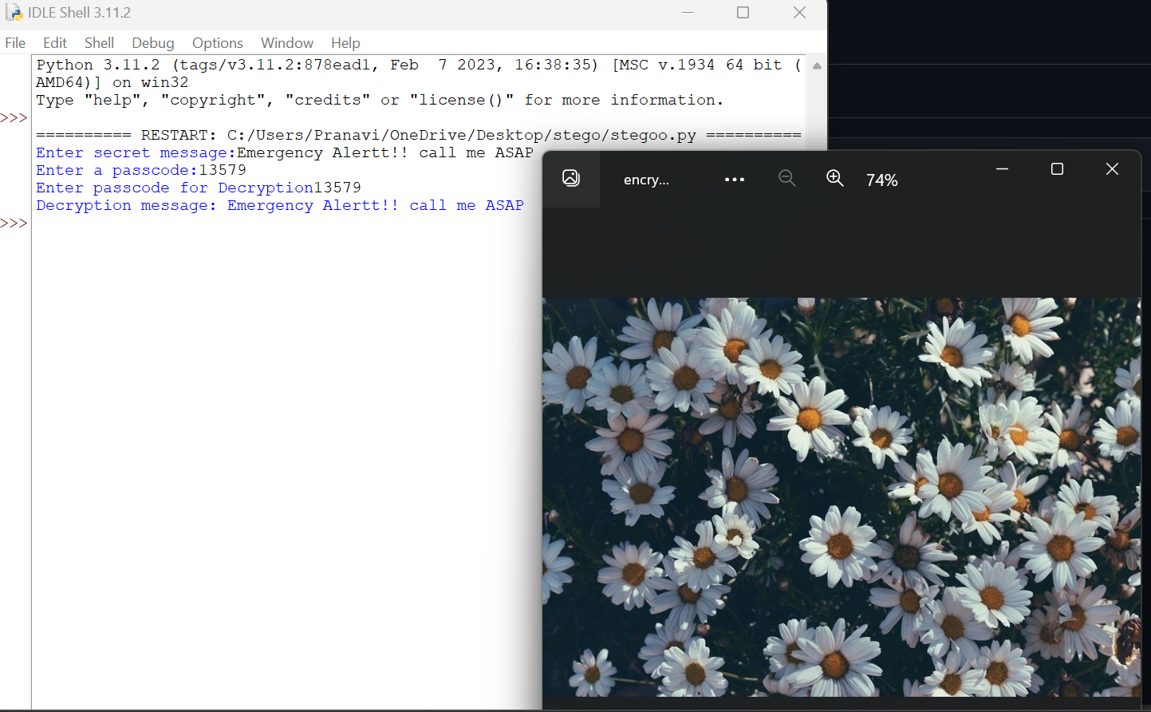

Slide 12
links
GitHub Repository :
https://github.com/pranavitan/STEGANOGRAPHY-HIDING-MESSAGE-IN-AN-IMAGE-PROJECT.git
Research Paper on Steganography Principles:
Steganography: The Art of Hiding: https://petapixel.com/2015/08/07/a-look-at-photo-steganography-the-hiding-of-secrets-inside-digital-images/
A Survey of Steganography Techniques: https://arxiv.org/pdf/1901.03892
Principles of Steganography: http://www.astrj.com/
Steganography Wikipedia:
https://en.wikipedia.org/wiki/Steganography

